Slide 1
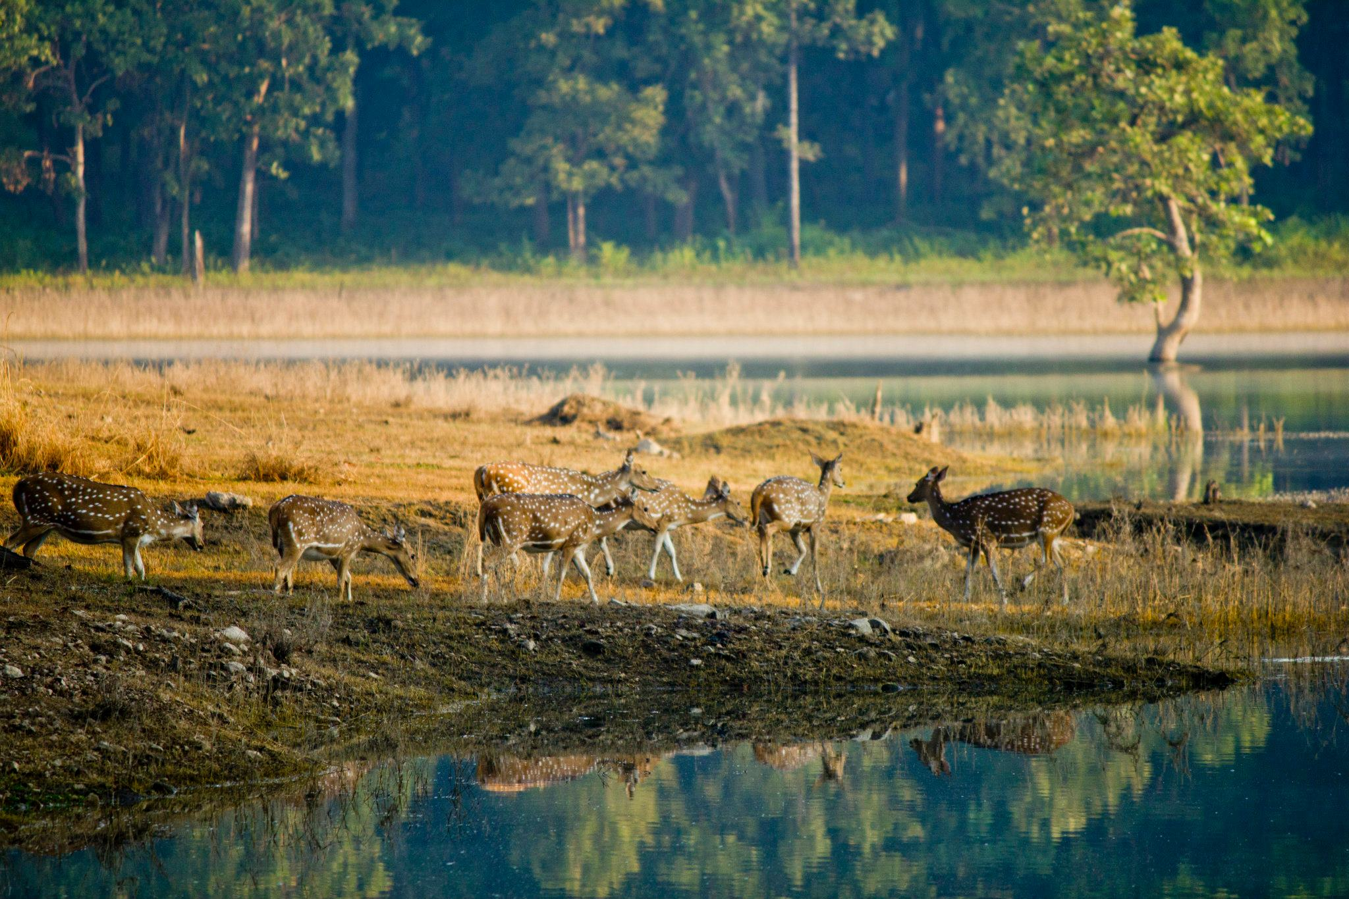
Land use and land cover change detection and decline in tiger population in central India.
Tania Banerjee
Advisor: Dr. Jun Luo
Department of Geography, Geology and Planning

Slide 2
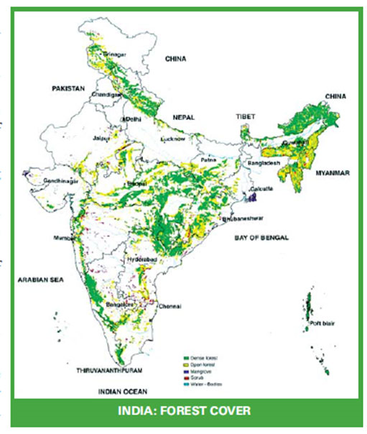
Background
After Green Revolution in 1970s, the deforestation continued for decades.
Since then, tiger was declared as an endangered species.
Human settlement near protected areas causes conversion of forests in agricultural land.
More agricultural land was in demand so as to feed the increasing population.
Tiger population declined from 100,000 in 1900s to 4,000 in 1970s.

Slide 3
Research Objectives
To find the land use and land cover change since 2009 to 2016.
Find the change in forest over the years.
To find the relationship between the tiger mortality and deforestation.
Suggestion to policy maker and Environmentalist

Slide 4
Why Tigers?
Tiger is the national animal of India.
Being endangered, tiger is the biggest concern for environmentalist.
Saving them is equivalent to saving ecosystem.
tiger population declined from 100,000 to 1700s to 4000 in 1900s.

Slide 5
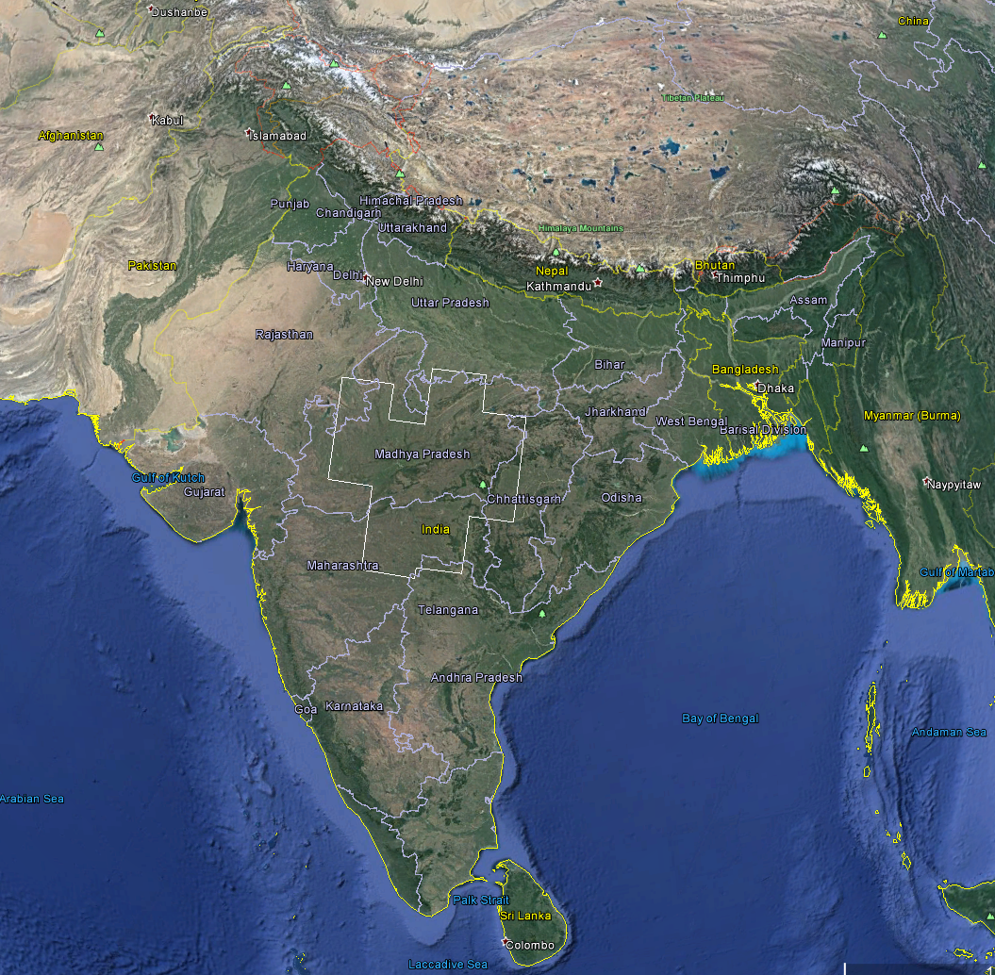
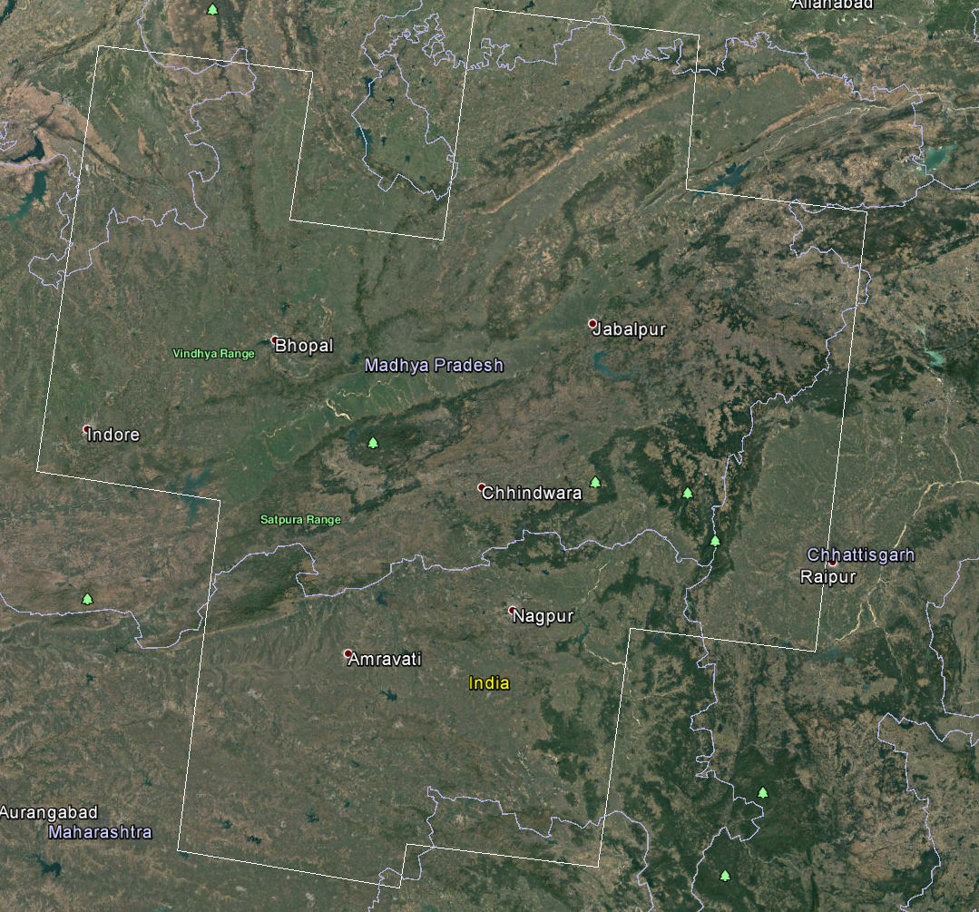
Study area
The study area is central India because of the highest number of tiger reserves.
Almost 19 protected areas for tigers.
Area:428K sq. km
Fig 2: The satellite image of central India.
Source: Google Earth Pro 7.1.5

Slide 6
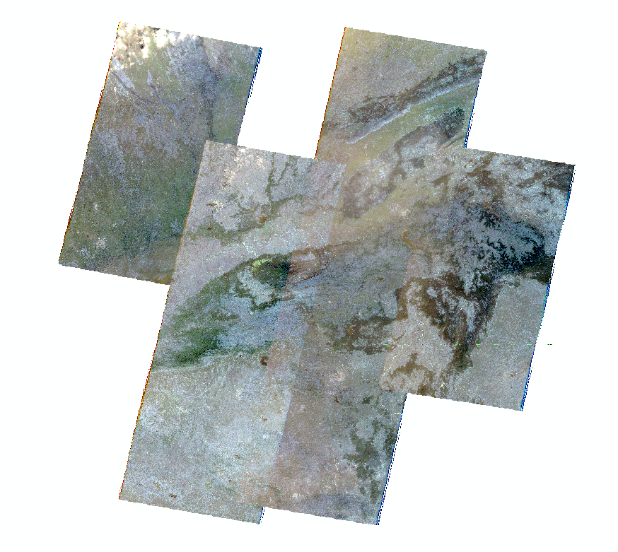
Study Area
Altitude: 284 m to 950 m above main sea level.
Located in states of Maharashtra, Madhya Pradesh and Chhattisgarh.
Majorly surrounded by big cities and high populated areas.

Slide 7
Data
Images
USGS Earth Explorer
http://earthexplorer.usgs.gov/
USGS Landsat
http://www.landsat.usgs.gov/
ArcGIS Image Server
Tiger mortality data
Wildlife Protection Society of India
http://www.wpsi-india.org
National Tiger Conservation Authority/ Project Tiger
http://projecttiger.nic.in/
Official database National Tiger Conservation Authority
http://www.tigernet.nic.in/
Open government data Platform (India)

Slide 8
Images Used | Year | Source
Landsat 5 ETM | 2009 | USGS Earth Explorer
ArcGIS image server | 2010 | ArcGIS Online
Landsat 5 ETM | 2011 | USGS Earth Explorer
ArcGIS image server | 2015 | ArcGIS Online
Landsat 8 | 2016 | USGS Earth Explorer

Slide 9
Methods
Landsat Image Classification:
Maximum supervised classification
Accuracy assessment
Tabulating areas of Patches
Statistical Methods : Spatially multivariate Regression.

Slide 10
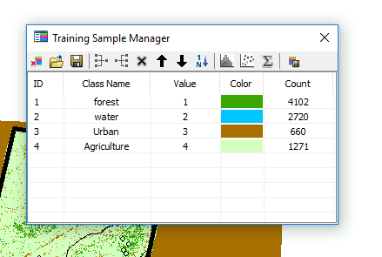
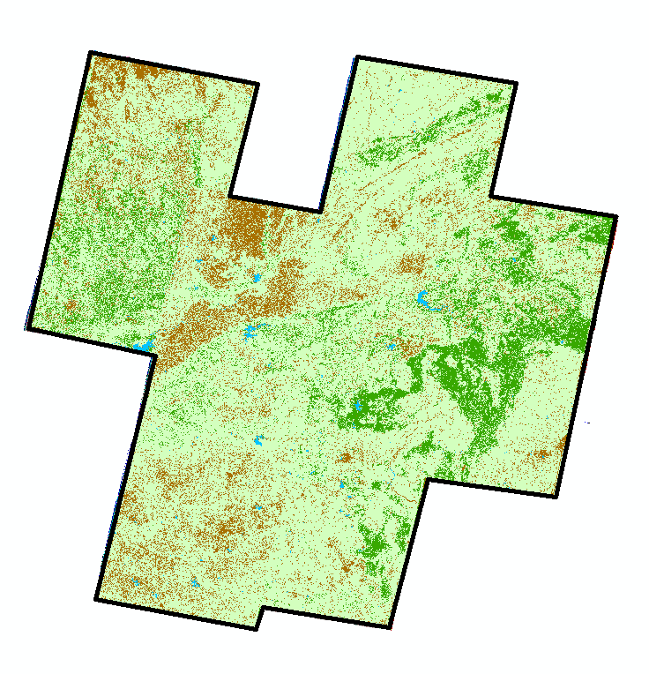
Supervised Classification methods
The user selects representative samples for each land cover class in the digital image called “training sites”.
These training set were used to categories pixels of similar reflectance values into units that were labeled after areas of identifiable features, such as forest, settlements, agricultural such on.

Slide 11
Accuracy Assessment
This methods is used to find the overall accuracy and Kappa value of the classification result.
It compares classified image to another data source that is considered to be accurate or ground truth data.
Select random points and creating confusion matrix
In this case,the accuracy ranges from 64% to 86.% which is good

Slide 12
Change in forest
year | Water (% of total ) | Forest (% of total) | Urban (% of total) | Agriculture (% of total)
2009 | 0.511440109 | 12.1277512 | 13.05004195 | 74.31076674
2010 | 0.807191701 | 27.18867583 | 15.69211684 | 56.31201563
2011 | 1.132994741 | 20.81461405 | 22.45327877 | 55.59911243
2015 | 1.146948934 | 18.76544479 | 5.843795758 | 74.24381052
2016 | 0.437207034 | 13.26019724 | 34.72625153 | 51.5763442

Slide 13
Statistical analysis

Slide 14
Limitations and Constraints
In first half of the project, no proper shape files were found of the forests.
Landsat images do not have high resolutions.
No accurate image classification
The tiger mortality data shows the number of tigers died in a patch instead of a particular point.
Therefore, the co-relation is generalized.

Slide 15
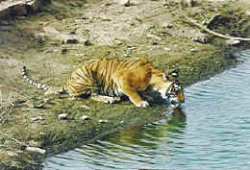
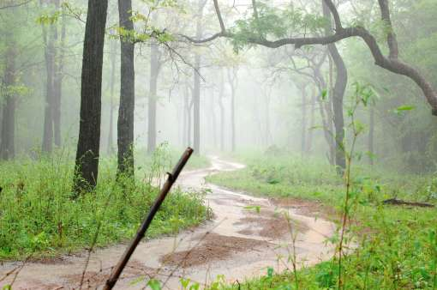
Conclusion
Consequences of Green Revolution.
Conversion of forest land into agriculture.
Suggestion to policy maker and environmentalist.

Slide 16
References
Pohl, C., & Van Genderen, J. L. (1998). Review article multisensor image fusion in remote sensing: concepts, methods and applications. International journal of remote sensing, 19(5), 823-854.
Kwarteng, A. Y., & Al-Ajmi, D. (1997). Satellite remote sensing applications in the State of Kuwait. Kuwait Institute for Scientific Research.

Slide 17

Thank you!!
Thank you!

